Slide 1
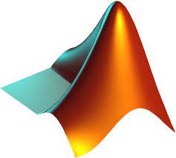

Communication Design
# LAB.8 Wireless Communications
OFDM
Ass.Lec.Ammar Alabbassi

Slide 2
Course Outline:
1- Simulate a Basic Digital Communications Link
Implement the essential components of a single-carrier digital communications system, including additive white Gaussian noise.
2- Pulse-Shaping Filters
Incorporate transmit and receive filters into your simulation.
3- Multipath Channels
Model a multipath channel and evaluate the impact on link quality.
4- OFDM
Implement orthogonal frequency-division multiplexing (OFDM), a multicarrier modulation scheme.

Slide 3
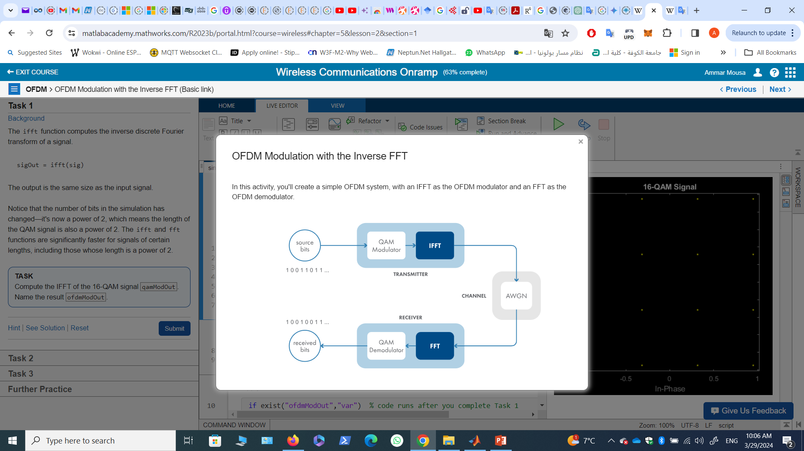
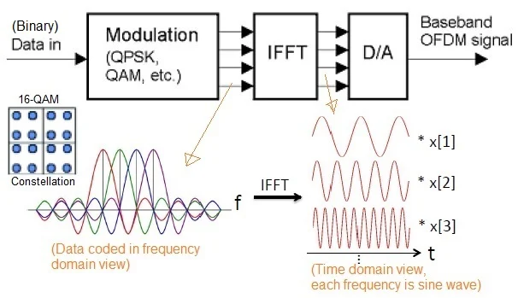
4- OFDM
In OFDM, (IFFT) is used at the transmitter to convert the parallel data streams into parallel subcarriers. This process allows for efficient modulation of multiple subcarriers simultaneously. The IFFT operation converts the frequency domain representation of the data into the time domain, which is essential for transmission over the channel. This helps in reducing the complexity of the modulator and makes it easier to implement in hardware.

Slide 4
OFDM Modulation with the Inverse FFT (Basic link)

Slide 5
Task 1
This code sets up a 16-QAM link.
numBits = 32768; % power of 2, to optimize performance of fft/ifft
modOrder = 16; % for 16-QAM
srcBits = randi([0,1],numBits,1);
qamModOut = qammod(srcBits,modOrder,"InputType","bit","UnitAveragePower",true);
scatterplot(qamModOut)
title("16-QAM Signal")

Slide 6
Task 1
Background
The ifft function computes the inverse discrete Fourier transform of a signal.
sigOut = ifft(sig)
The output is the same size as the input signal.
Notice that the number of bits in the simulation has changed—it's now a power of 2, which means the length of the QAM signal is also a power of 2. The ifft and fft functions are significantly faster for signals of certain lengths, including those whose length is a power of 2.
TASK
Compute the IFFT of the 16-QAM signal qamModOut. Name the result ofdmModOut.
ofdmModOut = ifft(qamModOut)

Slide 7
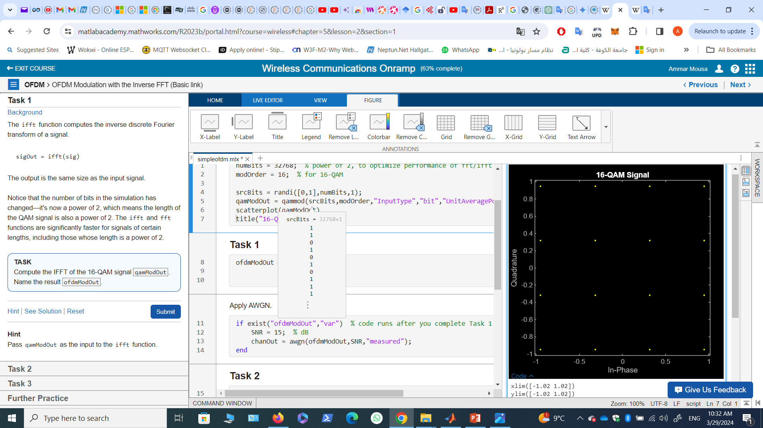
Task 1
Apply AWGN.
if exist("ofdmModOut","var") % code runs after you complete Task 1
SNR = 15; % dB
chanOut = awgn(ofdmModOut,SNR,"measured");
end

Slide 8
Task 2
Once you've created the variable ofdmModOut in the script, it is sent over a noisy channel.
Next, in the receiver, you need to "undo" the IFFT by performing an FFT.
The fft function computes the discrete Fourier transform, via the fast Fourier transform algorithm.
sigOut = fft(sig)
TASK
Compute the FFT of the received signal chanOut. Name the result ofdmDemodOut.
ofdmDemodOut = fft(chanOut)
Demodulate back into bits, then calculate the BER.
if exist("ofdmDemodOut","var") % code runs after you complete Task 2
qamDemodOut = qamdemod(ofdmDemodOut,modOrder,"OutputType","bit","UnitAveragePower",true);
numBitErrors = nnz(srcBits~=qamDemodOut)
BER = numBitErrors/numBits
end
numBitErrors = 125
BER = 0.0038

Slide 9
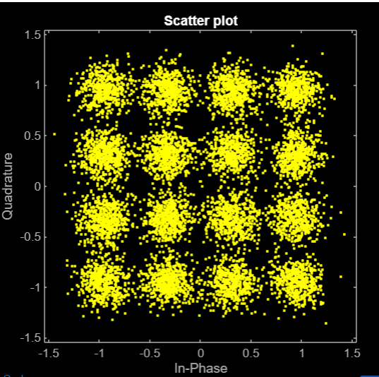
Task 3
Since the OFDM demodulator output is a 16-QAM signal, you can look at its scatter plot.
TASK
Create a scatter plot of the OFDM demodulator output ofdmDemodOut.
scatterplot(ofdmDemodOut)

Slide 10
OFDM Modulation with the Inverse FFT (Channel effects)

Slide 11
Task 1
Channel: multipath channel and/or AWGN
The script simulates the same OFDM link from before, but now you can modify the channel model interactively.
TASK
Model a multipath channel by enabling the hasMultipath .
OFDM Modulation with the Inverse FFT
%This code sets up a 16-QAM link with OFDM modulation.
numBits = 32768; % power of 2, to optimize performance of fft/ifft
modOrder = 16; % for 16-QAM
srcBits = randi([0,1],numBits,1);
qamModOut = qammod(srcBits,modOrder,"InputType","bit","UnitAveragePower",true);
ofdmModOut = ifft(qamModOut);

Slide 12
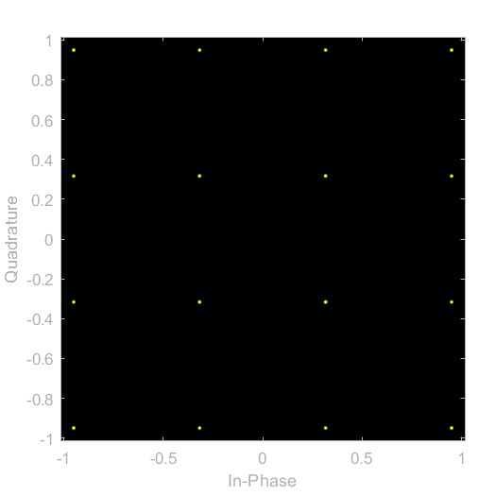
Task 1
hasMultipath =0; % disabling multipath channel effects
hasAWGN = 0; % disabling AWGN channel effects
SNR = 17;
chanOut = channel(ofdmModOut,hasMultipath,hasAWGN,SNR);
Demodulate the received signal and calculate the BER.
ofdmDmodOut = fft(chanOut);
scattereplot(ofdmDemodOut)
title("OFDM Demodulator Output")
qamDemodOut = qamdemod(ofdmDemodOut,modOrder,"OutputType","bit","UnitAveragePower",true);
numBitErrors = nnz(srcBits~=qamDemodOut)
BER = numBitErrors/numBits

Slide 13
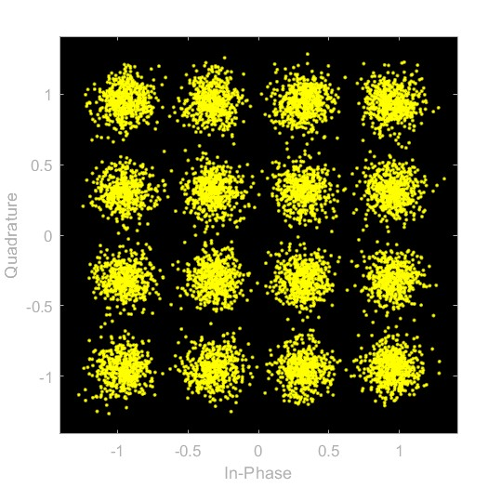
Task 1
hasMultipath =0; % disabling multipath channel effects
hasAWGN = 1; % enabling AWGN channel effects
SNR = 17;
chanOut = channel(ofdmModOut,hasMultipath,hasAWGN,SNR);
Demodulate the received signal and calculate the BER.
ofdmDmodOut = fft(chanOut);
scattereplot(ofdmDemodOut)
title("OFDM Demodulator Output")
qamDemodOut = qamdemod(ofdmDemodOut,modOrder,"OutputType","bit","UnitAveragePower",true);
numBitErrors = nnz(srcBits~=qamDemodOut)
BER = numBitErrors/numBits

Slide 14
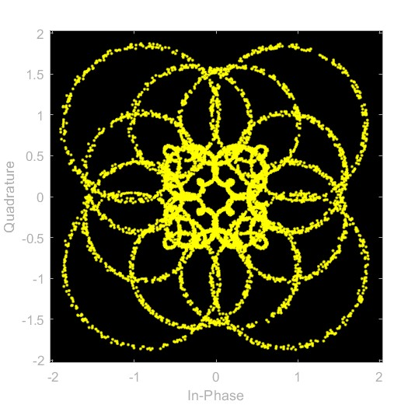
Task 1
hasMultipath =1; % enabling multipath channel effects
hasAWGN = 0; % disabling AWGN channel effects
SNR = 17;
chanOut = channel(ofdmModOut,hasMultipath,hasAWGN,SNR);
Demodulate the received signal and calculate the BER.
ofdmDmodOut = fft(chanOut);
scattereplot(ofdmDemodOut)
title("OFDM Demodulator Output")
qamDemodOut = qamdemod(ofdmDemodOut,modOrder,"OutputType","bit","UnitAveragePower",true);
numBitErrors = nnz(srcBits~=qamDemodOut)
BER = numBitErrors/numBits

Slide 15
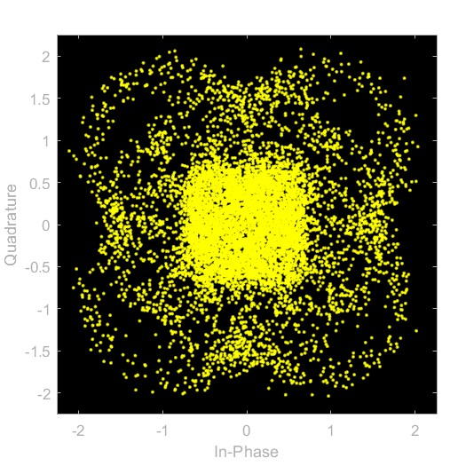
Task 1
hasMultipath =1; % enabling multipath channel effects
hasAWGN = 1; % enabling AWGN channel effects
SNR = 17;
chanOut = channel(ofdmModOut,hasMultipath,hasAWGN,SNR);
Demodulate the received signal and calculate the BER.
ofdmDmodOut = fft(chanOut);
scattereplot(ofdmDemodOut)
title("OFDM Demodulator Output")
qamDemodOut = qamdemod(ofdmDemodOut,modOrder,"OutputType","bit","UnitAveragePower",true);
numBitErrors = nnz(srcBits~=qamDemodOut)
BER = numBitErrors/numBits

Slide 16
Frequency Domain Equalization

Slide 17
Task 1
Background
When designing a practical OFDM system, the number of subcarriers (the FFT size) is an important design parameter.
The simulation in this activity is designed around the number of subcarriers—one 16-QAM symbol is assigned to each subcarrier, creating a single OFDM symbol. The number of source bits to generate is calculated by multiplying the number of subcarriers by the bits per 16-QAM symbol.
TASK
Define the number of subcarriers to be 8192 and store it in the variable numCarr. Then calculate the number of source bits to generate and store it in the variable numBits.
Frequency Domain Equalization
This code sets the simulation parameters.
modOrder = 16; % for 16-QAM
bitsPerSymbol = log2(modOrder) % modOrder = 2^bitsPerSymbol
mpChan = [0.8; zeros(7,1); -0.5; zeros(7,1); 0.34]; % multipath channel
SNR = 15 % dB, signal-to-noise ratio of AWGN
numCarr = 8192
numBits = numCarr*bitsPerSymbol

Slide 18
Task 2
After setting the number of source bits, the following script creates the source bit sequence and modulates it using 16-QAM.
The next step is to perform OFDM modulation, including a cyclic prefix.
The ofdmmod and ofdmdemod functions manage the cyclic prefix for you. All you have to do is specify the length of the cyclic prefix.
The cyclic prefix must be at least as long as the impulse response of the channel. But, it should also be reasonably short because it contains duplicate data that will be discarded. In this simulation, the multipath channel impulse response length is 17, so use a value slightly larger than that for the cyclic prefix length.
TASK
Define the cyclic prefix length to be 32 and store it in the variable cycPrefLen.
srcBits = randi([0,1],numBits,1);
qamModOut = qammod(srcBits,modOrder,"InputType","bit","UnitAveragePower",true);
cycPrefLen = 32

Slide 19
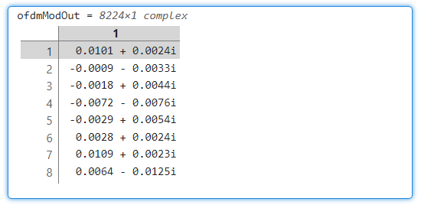
Task 3
Use the ofdmmod function to perform OFDM modulation, specifying the number of subcarriers and the cyclic prefix length.
sigOut = ofdmmod(sig,nCarr,cpLen)
TASK
Perform OFDM modulation on the signal qamModOut. Specify the number of subcarriers as numCarr and the cyclic prefix length as cycPrefLen. Name the output signal ofdmModOut.
ofdmModOut = ofdmmod(qamModOut,numCarr,cycPrefLen)
Channel: multipath channel and AWGN
if exist("ofdmModOut","var") % code runs after you complete Task 3
mpChanOut = filter(mpChan,1,ofdmModOut);
chanOut = awgn(mpChanOut,SNR,"measured");
end

Slide 20
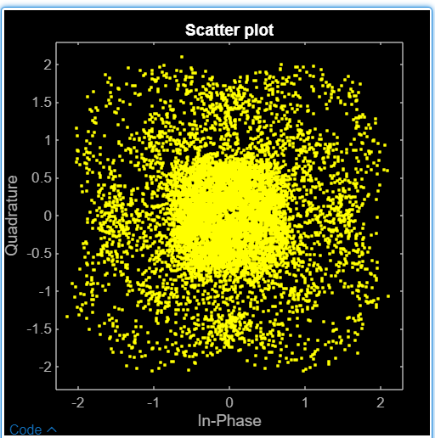
Task 4
Next, the OFDM modulated signal is sent over the channel to the receiver.
In the receiver, perform OFDM demodulation using the ofdmdemod function, again specifying the number of subcarriers and the cyclic prefix length.
sigOut = ofdmdemod(sig,nCarr,cpLen)
TASK
Perform OFDM demodulation on the signal chanOut. Specify the number of subcarriers as numCarr and the cyclic prefix length as cycPrefLen.Name the output signal ofdmDemodOut.
Create a scatter plot of the OFDM demodulator output.
ofdmDemodOut = ofdmdemod(chanOut,numCarr,cycPrefLen);
scatterplot(ofdmDemodOut)

Slide 21
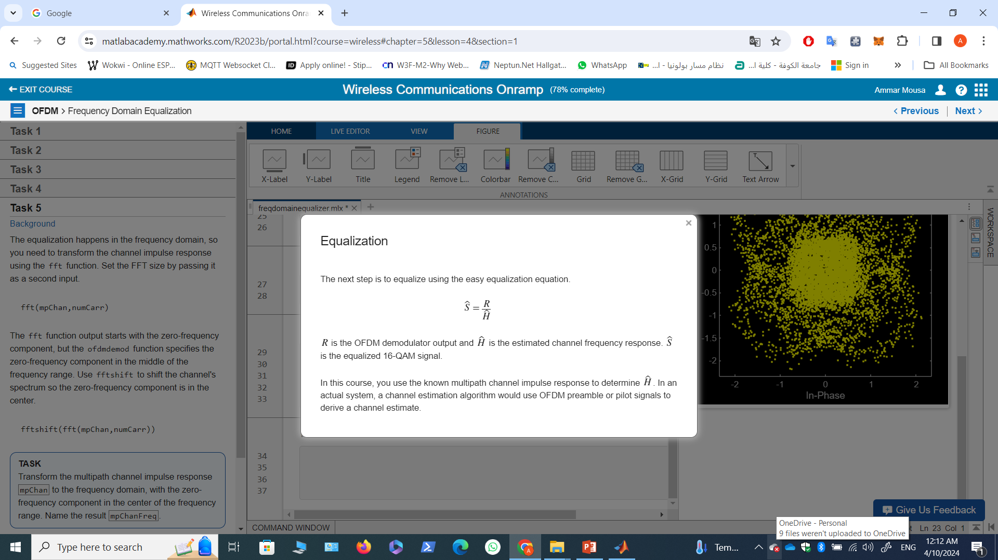
Task 5

Slide 22
Task 5
Background
The equalization happens in the frequency domain, so you need to transform the channel impulse response using the fft function. Set the FFT size by passing it as a second input.
fft(mpChan,numCarr)
The fft function output starts with the zero-frequency component, but the ofdmdemod function specifies the zero-frequency component in the middle of the frequency range. Use fftshift to shift the channel's spectrum so the zero-frequency component is in the center.
fftshift(fft(mpChan,numCarr))
TASK
Transform the multipath channel impulse response mpChan to the frequency domain, with the zero-frequency component in the center of the frequency range. Name the result mpChanFreq.
mpChanFreq = fftshift(fft(mpChan,numCarr));

Slide 23
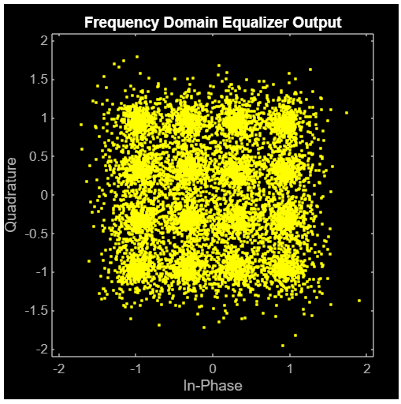
Task 6
Now you're ready to equalize the signal. To do so, divide it by the channel frequency response, element-wise.
Divide the two vectors element-wise using the ./ operator.
x ./ y
TASK
Equalize the signal ofdmDemodOut by dividing by mpChanFreq.
Name the equalized signal eqOut.
Create a scatter plot of the equalized signal.
eqOut = ofdmDemodOut ./ mpChanFreq;
scatterplot(eqOut)
title("Frequency Domain Equalizer Output")
Demodulate back into bits, then calculate the BER.
if exist("eqOut","var") % code runs after you complete Task 6
qamDemodOut = qamdemod(eqOut,modOrder,"OutputType","bit","UnitAveragePower",true); numBitErrors = nnz(srcBits~=qamDemodOut)
BER = numBitErrors/numBits
end
numBitErrors = 1312
BER = 0.0400

Slide 24
Null Subcarriers

Slide 25
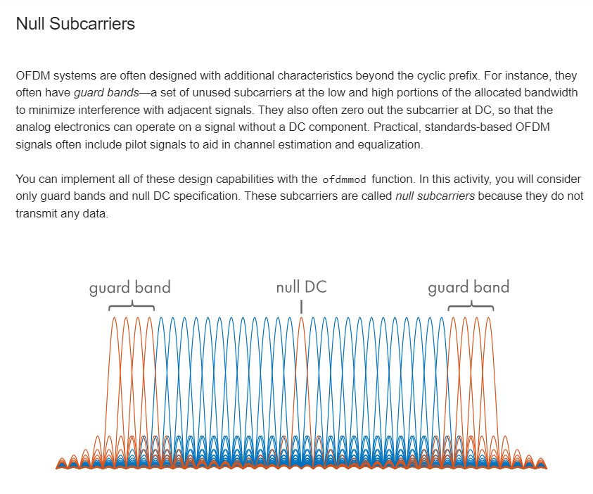

Slide 26
Task 1
Null Subcarriers
This code sets the simulation parameters.
modOrder = 16; % for 16-QAM
bitsPerSymbol = log2(modOrder) % modOrder = 2^bitsPerSymbol
mpChan = [0.8; zeros(7,1); -0.5; zeros(7,1); 0.34]; % multipath channel
SNR = 15 % dB, signal-to-noise ratio of AWGN
numCarr = 8192; % number of subcarriers
cycPrefLen = 32; % cyclic prefix length

Slide 27
Task 1
Background
In MATLAB, you identify a subcarrier by its index. The subcarriers are numbered from left to right, starting with 1 and ending with numCarr. The ofdmmod and ofdmdemod functions order the subcarriers from the most negative frequencies to the most positive frequencies, with the zero-frequency component in the middle.
To specify the guard band indices, first set the number of subcarriers in each guard band. Then, you can define the guard band indices using the : operator. The left guard band indices are defined as follows.
1:numGBCarr
Similarly, you can define the right guard band indices.
(numCarr-numGBCarr+1):numCarr
TASK
Define the guard band size as numCarr/16 and store it in the variable numGBCarr.
Define the left and right guard band indices and store them in the variables gbLeft and gbRight,respectively.
numGBCarr = numCarr/16
gbLeft = 1:numGBCarr
gbRight = (numCarr-numGBCarr+1):numCarr

Slide 28
Task 2
The ofdmmod function specifies the zero-frequency component in the middle of the frequency range. This means the DC null subcarrier is the center index. When there is an even number of subcarriers, the DC null index is defined as follows.
numCarr/2 + 1
To create the column vector of null subcarrier indices, concatenate the left guard band, DC null, and right guard band indices, and then transpose.
[left dc right]‘
TASK
Define the DC null index and store it in the variable dcIdx.
Create a column vector containing the null subcarrier indices and name it nullIdx.
dcIdx = (numCarr/2)+1
nullIdx = [gbLeft dcIdx gbRight]'

Slide 29
Task 3
The total number of subcarriers is numCarr. However, not all subcarriers are data subcarriers.
This simulation sends one 16-QAM symbol per data subcarrier, which means the length of the source bit sequence is based on the number of data subcarriers.
To determine the number of data subcarriers, subtract the number of null subcarriers from the total number of subcarriers.
The number of source bits to generate is then the number of data subcarriers multiplied by the bits per 16-QAM symbol.
TASK
Calculate the number of data subcarriers and store it in the variable numDataCarr. Then calculate the number of source bits to generate and store it in the variable numBits.
numDataCarr = numCarr - length(nullIdx)
numBits = numDataCarr*bitsPerSymbol;

Slide 30
Task 4
After setting the number of source bits, the script below creates the source bit sequence and modulates it using 16-QAM.
Now you can use the ofdmmod function to perform OFDM modulation. To specify the null subcarriers, pass the null index vector as a fourth input.
sigOut = ofdmmod(sig,nCarr,cpLen,nullIdx)
TASK
Perform OFDM modulation on the signal qamModOut. Specify the number of subcarriers numCarr, the cyclic prefix length cycPrefLen, and the null subcarrier indices nullIdx.
Name the output signal ofdmModOut.
Create the source bit sequence and modulate using 16-QAM.
if exist("numBits","var") % code runs after you complete Task 3
srcBits = randi([0,1],numBits,1);
qamModOut = qammod(srcBits,modOrder,"InputType","bit","UnitAveragePower",true);
end
ofdmModOut = ofdmmod(qamModOut,numCarr,cycPrefLen,nullIdx);

Slide 31
Task 4
Channel: multipath and AWGN
if exist("ofdmModOut","var") % code runs after you complete Task 4
mpChanOut = filter(mpChan,1,ofdmModOut);
chanOut = awgn(mpChanOut,SNR,"measured");
end

Slide 32
Task 5
Next, the OFDM modulated signal is sent over the channel to the receiver.
Perform OFDM demodulation on the received signal using the ofdmdemod function. Because null subcarriers were used,
the function needs two additional inputs: the symbol sampling offset and the null index vector.
sigOut = ofdmdemod(sig,nCarr, ... cpLen,symOffset,nullIdx)
The symbol sampling offset is the number of signal samples to discard before performing the FFT. It can be any value from 0 to the cyclic prefix length. To remove information corrupted by the multipath channel, it should be larger than the length of the multipath channel impulse response.
TASK
Perform OFDM demodulation on the received signal chanOut. Specify the number of subcarriers numCarr, the cyclic prefix length cycPrefLen, and the null subcarrier indices nullIdx. For the symbol sampling offset, use the cyclic prefix length cycPrefLen.
Name the output signal ofdmDemodOut.
ofdmDemodOut = ofdmdemod(chanOut,numCarr,cycPrefLen,cycPrefLen,nullIdx);

Slide 33
Task 6
The next step is to equalize the signal.
Transform and shift the channel impulse response with the fft and fftshift functions as you did previously.
fftshift(fft(mpChan,numCarr))
The channel frequency response has numCarr frequency components. However, the OFDM demodulator output contains only the data subcarriers. To perform the element-wise division, you need to remove the null subcarrier frequency components from the channel frequency response.
You can remove specific elements of a vector using indexing.
x(idx) = [ ]
TASK
Transform the multipath channel impulse response mpChan to the frequency domain and shift the zero-frequency component to the center of the spectrum. Name the result mpChanFreq.
Remove the elements of mpChanFreq that correspond to the null subcarrier indices.
mpChanFreq = fftshift(fft(mpChan,numCarr));
mpChanFreq(nullIdx) = [ ];

Slide 34
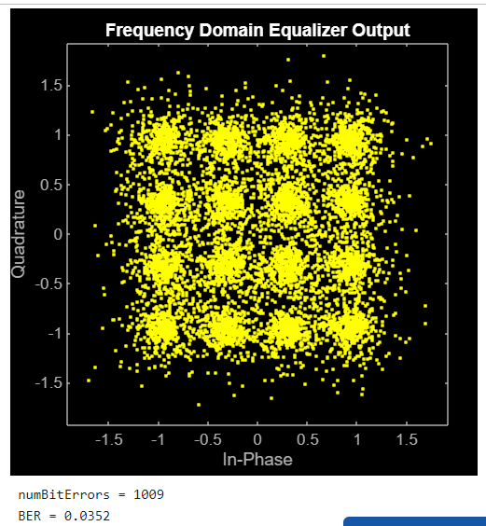
Task 7
TASK
Equalize the signal ofdmDemodOut by dividing by mpChanFreq. Name the equalized signal eqOut.
Create a scatter plot of the equalized signal.
eqOut = ofdmDemodOut ./ mpChanFreq;
scatterplot(eqOut)
title("Frequency Domain Equalizer Output")
Demodulate back into bits, then calculate the BER.
if exist("eqOut","var") % code runs after you complete Task 7
qamDemodOut = qamdemod(eqOut,modOrder,"OutputType","bit","UnitAveragePower",true);
numBitErrors = nnz(srcBits~=qamDemodOut)
BER = numBitErrors/numBits
end

